Slide 1

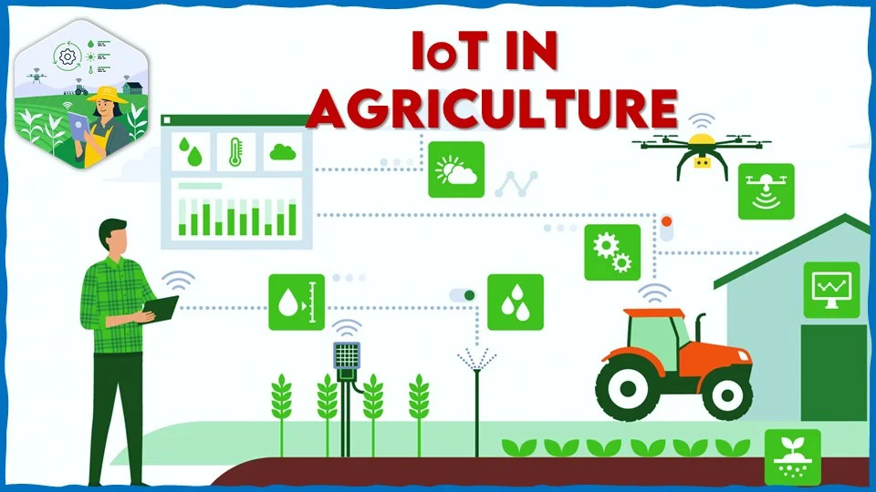



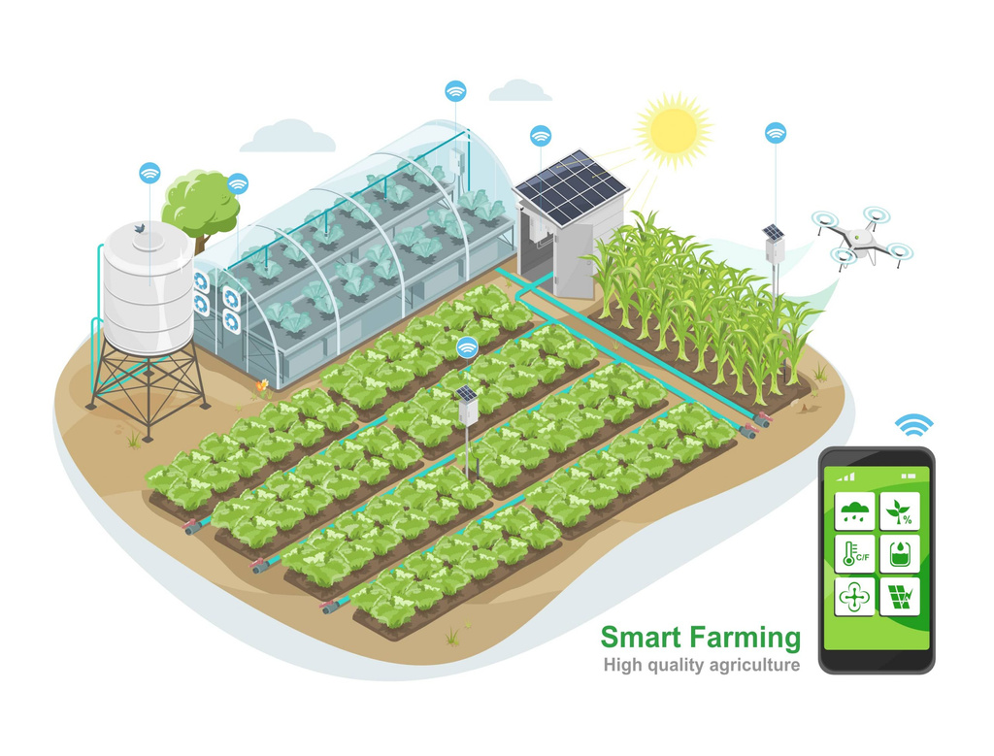

AGRISENSE APP
Smart Agriculture IoT System
Present by : Rushikesh Sable
PRN:- 202201070107
BTECH(ENTC)

Slide 2

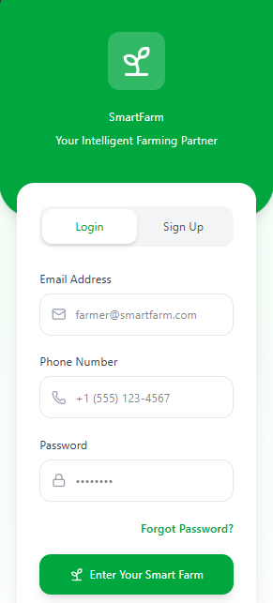

DESIGN BRIEF
Agrisense is a Smart Agriculture IoT mobile application that enables farmers to monitor soil conditions, automate irrigation, receive AI insights, and make data-driven decisions.
The goal of this project is to create a simple, intuitive, multilingual interface that converts complex IoT sensor data into actionable recommendations.
Objectives
Provide real-time visibility of field conditions
Deliver AI-based predictions for irrigation, pests, and crop yield
Enable automation control of IoT devices
Improve farmer confidence through easy-to-understand visual insights

Slide 3

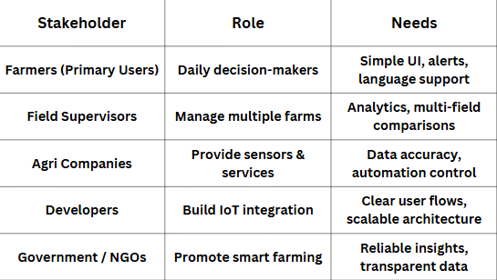


STAKEHOLDER MAPPING

Slide 4



USER INTERVIEW SUMMARY
Participants: farmers + field supervisors
Methods: In-person interviews & WhatsApp voice calls
Key Findings
Farmers want simple, big visuals — not complex graphs
Alerts need to be clear (color-coded)
Language is important (Hindi/Marathi support needed)
Many farmers are interested in auto irrigation
They don’t trust raw values unless AI explains the meaning
Common Quotes
“Numbers are confusing… tell me what to do.”
“If moisture is low, I want the app to warn me early.”
“Graphs should be simple to understand.”

Slide 5

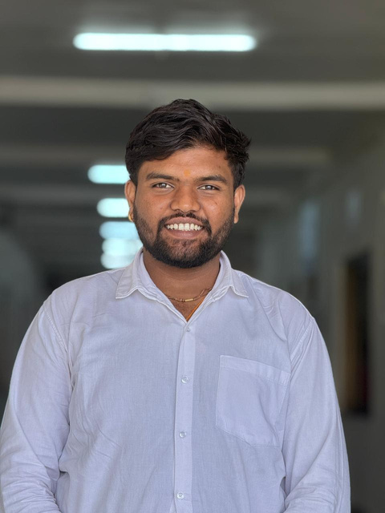

USER PERSONA 01
Name: Bharat Mankar
Age: 28
Occupation: Farmer
Location: Rural Maharashtra
Tech Skill: smartphone user
Goals:
Monitor moisture & temperature easily
Reduce water wastage
Know early pest threats
Use local language
Frustrations:
Complex agricultural apps
Hard-to-read graphs
No actionable insights
Cannot detect problems early
Motivation: Improve crop quality & stable income.

Slide 6

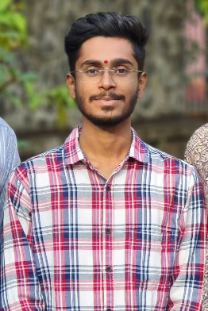
USER PERSONA 02
Name: Abhishek akote
Age: 27
Occupation: Farmer
Location: Rural Maharashtra
Tech Skill: smartphone user
Goals:
Monitor multiple farm fields at once
Track sensor health and device connectivity
Generate reports to share with farm owners
Frustrations:
Switching between apps to manage multiple fields
No clear history of alerts or actions taken
Difficult to compare sensor performance
Efficient farm management, reduced workload, and accurate decision-making for better crop outcomes.

Slide 7

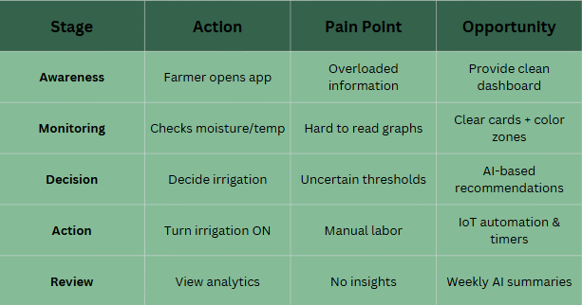

CUSTOMER JOURNEY
MAPPING
Name: Bharat Mankar
Age: 28
Occupation: Farmer
Location: Rural Maharashtra
Tech Skill: smartphone user

Slide 8


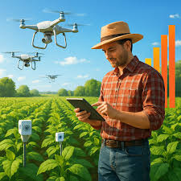
EMPATHY MAPPING
Says:
“I need to know when to irrigate.”
“I want an app in my language.”
Thinks:
“Is my field getting enough water?”
“Will pests affect my crop soon?”
Does:
Checks moisture manually
Calls field workers for updates
Feels:
Worried about crop loss
Overwhelmed by data
Relieved when alerts are clear

Slide 9
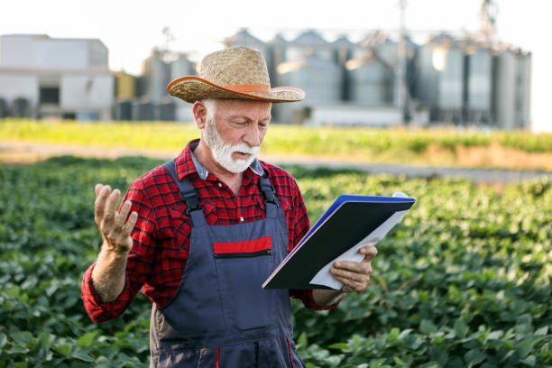
Problem Statement
Primary Problem:
Farmers struggle to interpret raw IoT sensor values (moisture, temperature, pH, humidity) and cannot convert them into meaningful decisions.
Secondary Problems:
No clear early warnings → crop damage
Existing apps provide too many numbers, fewer insights
Irrigation decisions are based on guesswork
No multilingual support for rural farmers
No unified platform for insights + automation
Why this matters:
Unclear data = poor decisions → reduced yield → financial loss.

Slide 10
Solution Overview
1. Real-time Data
• Moisture, temperature, humidity, pH
• Color-coded sensor cards
2. AI-Powered Insights
• Irrigation recommendations
• Pest probability
• Yield predictions
3. Smart Alerts
• Critical, warning & informational notifications
• Local language support
4. Automation Control
• IoT irrigation ON/OFF
• Auto mode & timer scheduling
5. Advanced Analytics
• Multi-field comparisons
• Trend charts
• PDF export reports

Slide 11
DESIGN PROCESS
A standard Design Thinking Framework was followed:
Empathize – Understand farmer pain points and technology limitations
Define – Convert insights into clear problem statements
Ideate – Explore visual concepts, features, and interaction flows
Prototype – Create low-fi → mid-fi → high-fi Figma screens
Test – Evaluate usability, clarity, and decision efficiency
Refine – Iterate based on user feedback

Slide 12

DEFINE STAGE
Primary Problem
Farmers struggle to understand sensor readings and need simple, actionable, AI-powered insights instead of raw data.
Secondary Problems
Lack of early warnings leads to crop damage
Farmers need automation features to reduce effort
Current apps don’t support multilingual interfaces
How Might We (HMW) statements
HMW simplify sensor data through visual cues?
HMW help farmers take timely actions with AI suggestions?
HMW support multiple fields with easy navigation?
HMW reduce water usage through smart irrigation control?

Slide 13



AFFINITY MAPPING
Theme 1: Simplicity
Large cards, clear icons
Less text, more visuals
Theme 2: Automation
Auto irrigation mode
Smart alerts
Theme 3: AI Intelligence
Crop predictions
Pest risk probability
Yield forecasting
Theme 4: Localization
Hindi/Marathi support
Regional weather models
Theme 5: Control & Transparency
View sensor node maps
Export analytics PDF

Slide 14


IDEATION STAGE
Concept Ideas
Real-time sensor cards with color coding
Field Map showing moisture zones
AI Insights hub with predictions
Automation panel with toggles & timers
Analytics dashboard comparing fields
Weather + irrigation scheduling
Multilingual onboarding & UI themes
Sketches Created For
Dashboard layout
AI insights screen
Sensor detail with trend chart
Alerts with severity filters

Slide 15

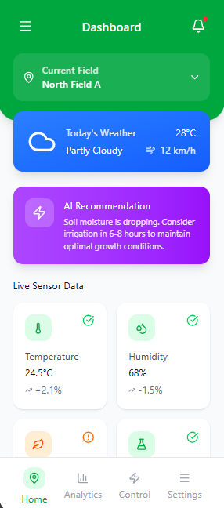
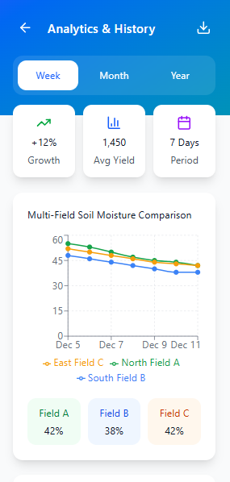

PROTOTYPE

Slide 16
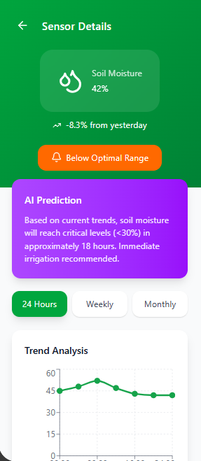
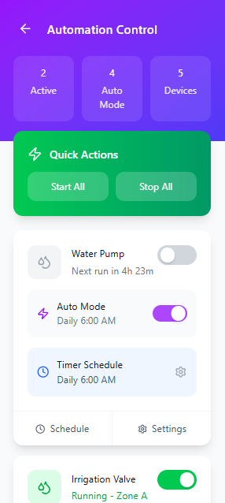
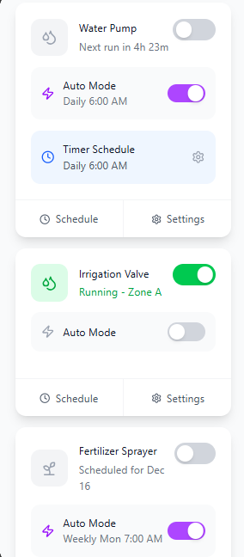
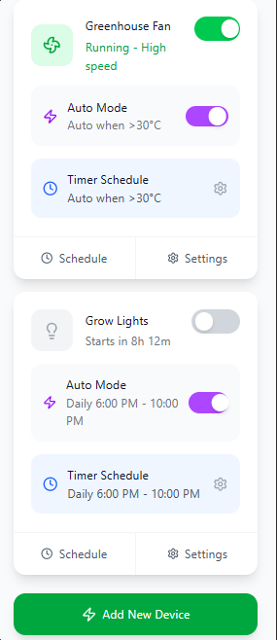
PROTOTYPE

Slide 17
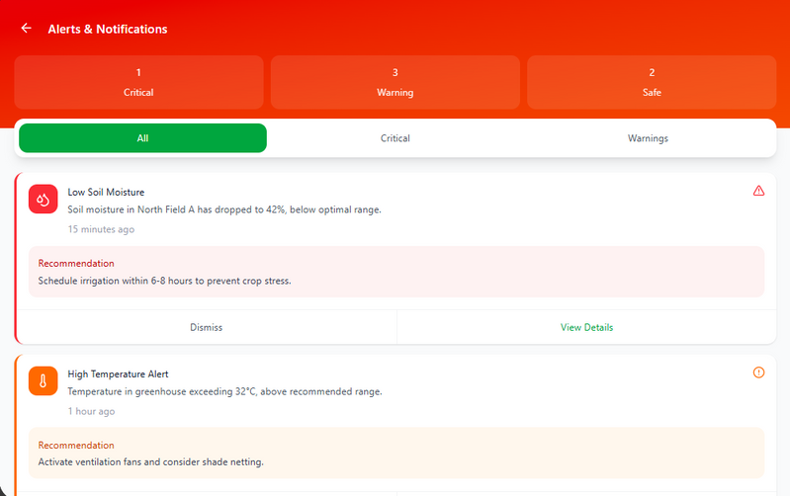
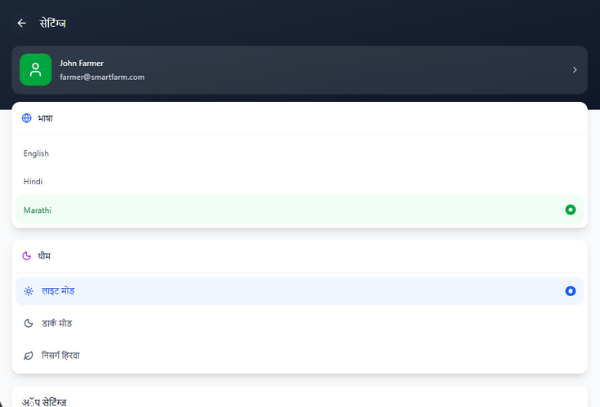
PROTOTYPE

Slide 18
CONCLUSION — IMPACT OF AGRISENSE
Key Achievements
✔ Faster irrigation decisions through clear sensor cards
✔ Reduced crop damage using AI-driven early alerts
✔ Intuitive automation control improving efficiency
✔ Multilingual support increasing accessibility
✔ Visual analytics improving long-term planning
UX Impact
Farmers felt confident interpreting live field conditions
App reduced dependency on guesswork
Increased adoption due to simple UI + local language
Future Enhancements
🔹 Voice Assistant for low-literacy users
🔹 Predictive disease detection
🔹 Offline mode for rural areas

Slide 19
Thank
You

